Slide 1
Introduction to Cloud Computing
Manoj (Manu)

Slide 2
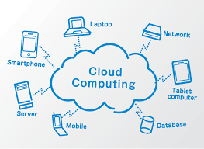

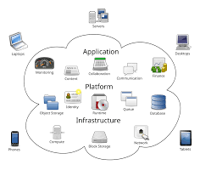
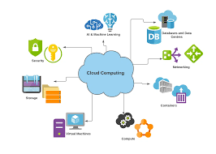
What is Cloud Computing

Slide 3
What is Cloud Computing
Cloud computing is the on-demand delivery of compute power, database storage, applications, and other IT resources through a cloud services platform via the internet, with pay-as-you-go pricing.
Notes:
The most basic way to define what the “cloud” is that it is a computer located somewhere
else that is accessed via the Internet and utilized in some way. Web services is also another
name for what people call the cloud.
The cloud is comprised of server computers located in large data centers in different
locations around the world. When you use a cloud service like Amazon Web Services (AWS),
you are utilizing the computers owned by AWS. AWS is a cloud services provider.
The computers contain various technology features and services, like building blocks, that can
be used to assemble solutions that help a user meet their business goals and technology
requirements. With cloud computing, organizations can consume on-demand computing and
storage resources rather than building, operating, and improving infrastructure on their own.

Slide 4
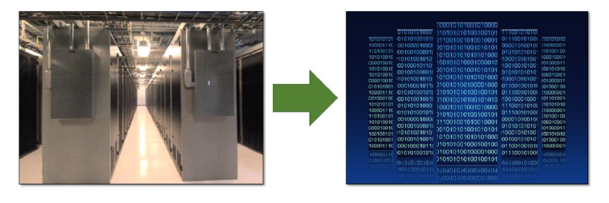
Before Cloud Computing
Cloud computing enables you to stop thinking of your infrastructure as hardware, and instead think of it (and use it) as software
Notes:
Cloud computing enables you to stop thinking of your infrastructure as hardware, and instead
think of it (and use it) as software. Before cloud computing, you would have to provision
capacity based on guessing theoretical maximum peaks. If you didn’t meet your projected
maximum peaks, or you exceeded them, you would be paying for expensive resources that
would stay idle or have insufficient capacity to meet your needs.

Slide 5
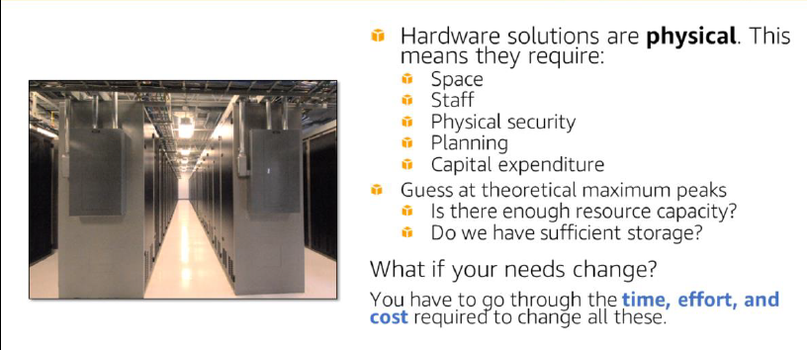
Before Cloud Computing
Notes:
Managing hardware takes away time and resources you could be using to improve your
architecture and your application. Hardware solutions are physical. This means they require
space, staff, physical security, planning and capital expenditure.
You have to guess at theoretical maximum peaks, asking if there is enough resource capacity
or if you have sufficient storage. What if your needs change? You have to go through the
time, effort, and cost required to change all of these.
For example, if you want to provision a new web site, you would have to go out and buy the
hardware, rack and stack it, put it in a data center, and then manage it or have someone else
manage it. This approach is very expensive.
Cloud computing addresses some of the issues in the traditional computing model. One of
the most prohibitive aspects of traditional computing is the significant up-front investment of
acquiring, provisioning, and maintaining on-premises infrastructure. Cloud computing can get
businesses up and running with a new solution in place quickly and with very low up-front
costs. Then, you can elastically scale up and down in an automated fashion so that you pay
only for what you use.
Cloud computing also allows you to select the services that best match your needs, giving you flexibility with a wide range of choices and the ability to change your configuration at will. All
of these services are provided on a secured infrastructure.

Slide 6
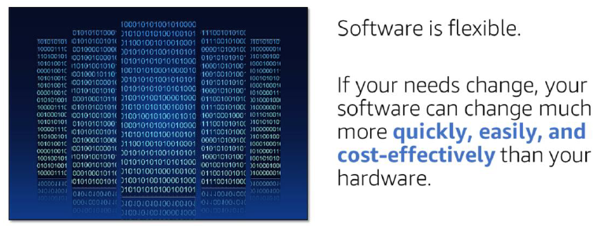
Utilizing Cloud Computing
Notes:
Accessing and using your infrastructure as software offers a number of benefits-flexibility in
particular. If your needs change, your software can change much more quickly, easily, and
cost-effectively than your hardware.
With a cloud services provider like AWS, you don't have to anticipate your hardware needs
ahead of time and then order, install, and set it up at your data center. You also don’t need to
undergo a long procurement cycle. With a few clicks, you can provision exactly what you
need-and it will be available to you in a few minutes.
That means you can provision and terminate resources as necessary on AWS, instead of
paying for hardware when you’re not using it. You can treat resources as temporary and
disposable resources, free from the inflexibility and constraints of a fixed and finite IT
infrastructure.
By harnessing the power of AWS, you can be more agile and efficient with change
management, testing, reliability, and capacity planning.

Slide 7
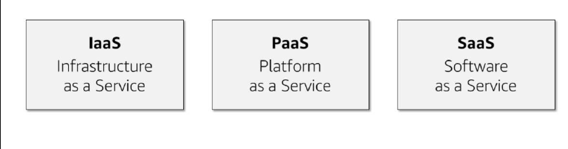
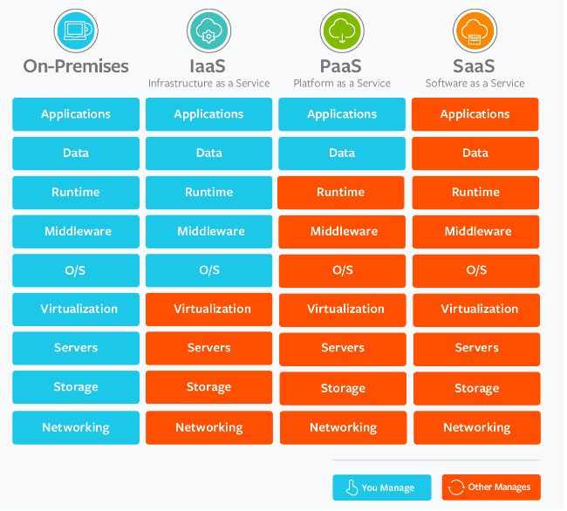
Three Service Models of Cloud Computing
Notes:
Cloud services can fall into one of three primary categories, based mainly around how much
control and responsibility you have over how the service is configured.
With IaaS (or Infrastructure as a Service), you manage the server, which can be
physical or virtual, as well as the operating system (Windows or Linux). In general, the
data center provider has no access to your server.
Basic building blocks for cloud IT include:
• Networking features
• Compute, and
• Data storage space
With PaaS (or Platform as a Service), someone else manages the underlying
hardware and operating systems. This enables you to run applications without
managing underlying infrastructure (for example -- patching, updates, maintenance,
hardware and operating systems). PaaS also provides a framework for developers
that they can build upon to create customized applications.
With SaaS (or Software as a Service), you manage your files, while the service
provider takes care of all of the data centers, servers, networks, storage,
maintenance, patching, etc. All you worry about is the software and how you want to
use it. You are provided with a complete product that is run and managed by the
service provider. Facebook and Dropbox are examples of SaaS. You manage your
Facebook contacts and Dropbox files, and the service providers manage the systems.

Slide 8
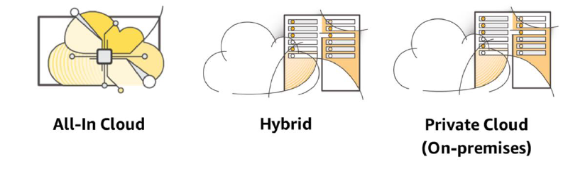
Three Cloud Deployment models
Notes:
"All-In" Cloud is a cloud-based application that is fully deployed in the cloud, and all parts of
the application run in the cloud. Applications in the cloud have either been created in the
cloud or have been migrated from an existing infrastructure. Cloud-based applications can be
built on low-level infrastructure pieces (for example, networking, compute or storage) or can
use higher-level services that provide abstraction from the management, architecting, and
scaling requirements of core infrastructure.
A hybrid deployment is a way to connect infrastructure and applications between cloudbased
resources and existing resources that are not located in the cloud. The most common
method of hybrid deployment is between the cloud and existing on-premises infrastructure
(sometimes called on-prem). On-premises infrastructure is located within the physical
confines of an enterprise, often in the company's data center. A hybrid deployment model is
used to extend an organization's infrastructure into the cloud while connecting cloud
resources to an internal system
When you run a cloud infrastructure from your own data center, that’s called on-premises or
private cloud. While this kind of deployment lacks many of the benefits of cloud computing, it
does provide dedicated resources and is a popular choice for organizations who need to meet
certain compliance standards. In most cases, this deployment model is the same as legacy IT infrastructure while using application management and virtualization to increase resource
utilization.

Slide 9
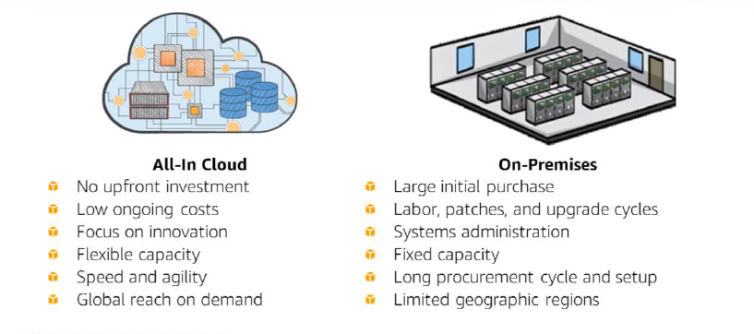
Public Cloud vs On premises

Slide 10
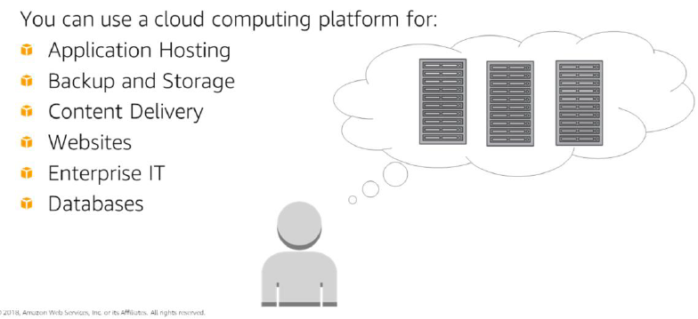
What we can do in the cloud
Notes:
You can use a cloud computing platform for the following:
• Application Hosting for an on-demand infrastructure to host internal or SaaS applications.
• Backup and Storage to store data and build dependable backup solutions.
• Content Delivery to distribute content worldwide, with high data transfer speeds.
• Host static and dynamic websites.
• Enterprise IT to host internal- or external-facing IT applications in AWS's secure
environment.
• Use a variety of scalable database solutions, from hosted enterprise database software to
non-relational database solutions.

Slide 11
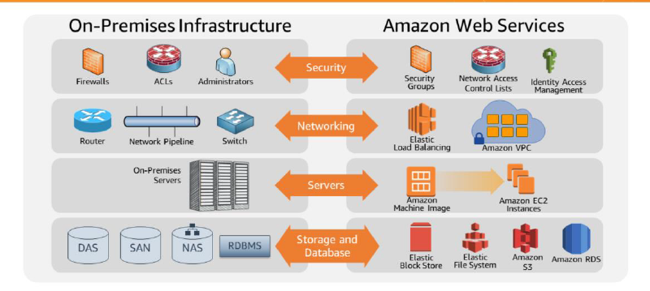
On Premises vs AWS
Notes:
Many AWS services have analogs in the traditional IT space and terminology. This side-byside
comparison shows how Amazon Web Services (AWS) products and services relate to a
traditional infrastructure. Pr

Slide 12
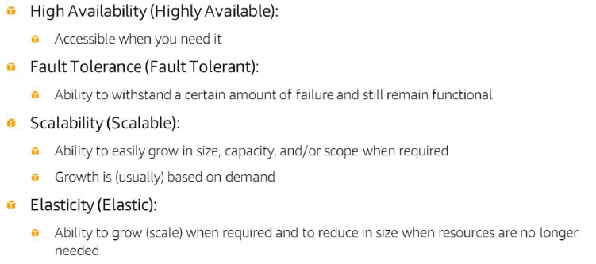
Important Cloud Terminology
Notes:
High availability refers to a resource that is accessible when you attempt to access it. For
example, if every time you go to the ATM to make a withdrawal it works as expected the
ATM is highly available; however, if you go to use it and there is a sign on the front that says
“Out of Order”, it is not highly available.
Fault tolerance is the ability to withstand a certain amount of failure and still remain
functional. It also refers to the ability of a system to be self-healing and return to full capacity
despite a failure. It is the ability of a system to fail in some way but still remain functional.
Scalability is the ability to easily grow in size, capacity, and/or scope when required
particularly in response to demand. If something cannot quickly grow in an easy manner it is
not scalable.
Elasticity is the ability to not only grow (or scale) when required, but also to reduce or
contract in size as needed. A system that is elastic can scale to grow as needed usually based on demand and contract as demand decreases.

Slide 13
Six Advantages of Cloud Computing
Advantage 1: Trade Capital Expense for Variable Expense.
Advantage 2: Benefit from massive economies of scale.
Advantage 3: Stop guessing about capacity.
Advantage 4: Increase speed and agility.
Advantage 5: Stop spending money running and maintaining data centers.
Advantage 6: Go global in minutes.
Notes:
The first advantage is to trade capital expense for variable expense.
Instead of having to invest heavily in data centers and servers before you know how
you’re going to use them, you can pay only when you use computing resources, and
pay for how much you use.
Capital expenses, or capex, are funds used by a company to acquire, upgrade, and maintain
physical assets such as property, industrial buildings, or equipment.
Advantage 2: Benefit from massive economies of scale.
Advantage number two is that you can benefit from massive economies of scale.
By using cloud computing, you can achieve a lower variable cost than you can get on
your own. Advantage 4: Increase speed and agility.
Advantage four is increased speed and agility.
In a cloud computing environment, new IT resources are only a click away, which
means you reduce the time it takes to make those resources available to your
developers from weeks to just minutes. This results in a dramatic increase in agility
for the organization, since the cost and time it takes to experiment and develop is
significantly lower.

Slide 14
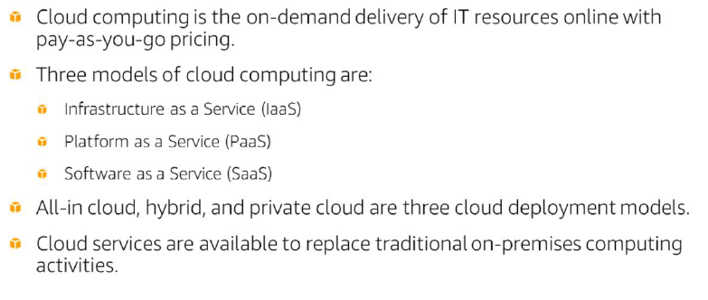
Summary

Slide 15
Self Study
Prepare notes for basics of Cloud computing and Advantages of Cloud computing.
AWS Account setup, GitHub personal account setup
Basics of networking.
Ipv4 and OSI model
SNAT, DNAT, Netmask
DNS, DHCP
IP address and CIDR.
Useful Ports and port numbers.
APIs, and types of API architecture, and API response codes.
Prepare QnA for all above concepts. (Try to prepare real time scenario questions)

